Slide 1
Parallelization of The 24 Game using Pthreads
Kevin Wang, Anthony Tu, Rahul Chander
EE/CSCI 451: Project Presentation
University of Southern California

Slide 2
Introduction
Game’s objective is to get to 24 using each number exactly once, through a series of mathematical operations (+ x ÷ –)
Used for basic arithmetic and to instill pattern recognition
Simple way to illustrate trends of parallelization
Parallelization could be beneficial for a 24 Game solver as there are many possible permutations to try to reach 24

Slide 3
Context
Distribute 24 cards to solve among a number of Pthreads
Each card has (4! * 64) = 1536 (in general) different permutations
Challenges in parallelization:
Coming up with a heuristic to further the benefits of parallelization

Slide 4
Objective
Parallelization on a brute force 24 Game solver
Introducing a heuristic to the 24 Game solver
Keep a table with most consistent numbers that lead to a solution
Parallelization on 24 Game solver with heuristic

Slide 5
Project Parallelization Hypothesis
Our heuristic will decrease the execution time by eliminating a large amount of permutations

Slide 6
Key idea
Parameters:
iterations
top_nums
num_threads
Pthreads algorithm divides the number of iterations by the number of threads so each thread is responsible for solving # of cards equal to iterations/num_threads

Slide 7
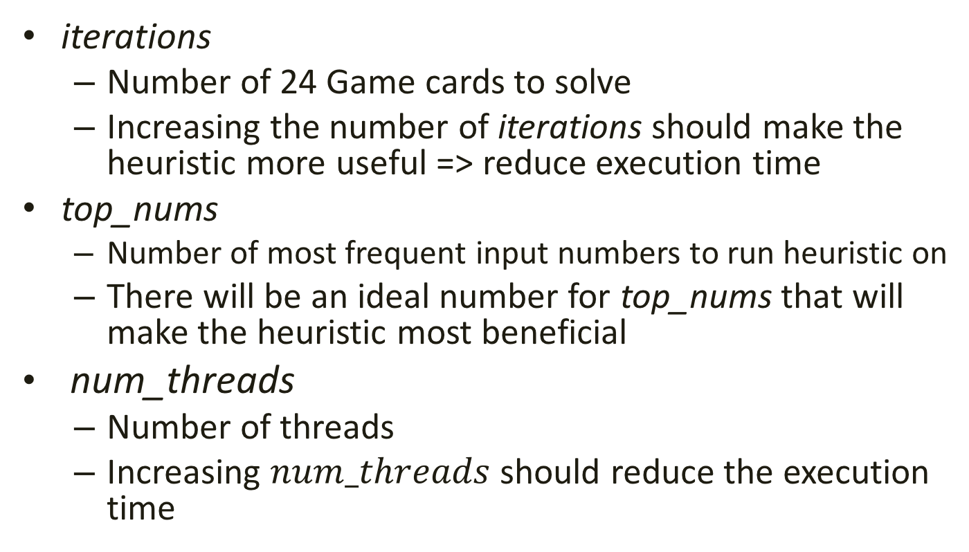
Explanation of Parameter
iterations
Number of 24 Game cards to solve
Increasing the number of iterations should make the heuristic more useful => reduce execution time
top_nums
Number of most frequent input numbers to run heuristic on
There will be an ideal number for top_nums that will make the heuristic most beneficial
num_threads
Number of threads
Increasing $num_threads$ should reduce the execution time

Slide 8
Experimental Setup
Approaches:
Naive
Pthreads
Heuristic

Slide 9
Results
Pthreads with no heuristic (1024 iterations)
Num. of Threads | Execution Time
1 | 143208343 ns
2 | 77403042 ns
4 | 42924015 ns
8 | 26442219 ns
16 | 15440874 ns
32 | 16185308 ns
64 | 17052280 ns
128 | 19670268 ns
256 | 25577141 ns
512 | 32157064 ns

Slide 10
Results
Pthreads with heuristic
Num. of Iterations | Num. of Threads | Execution Time

Slide 11
Analysis
Provide analysis of the results obtained.
Explain how the parameters are affecting the performance.

Slide 12
Conclusion
Summarize what you learned (or expected to learn) by doing this project

